Slide 1
Flow chemistry for supramolecular processes
Dr Anna Slater (she/her)
University of Liverpool
ETOC
24th Feb 2022

Slide 2
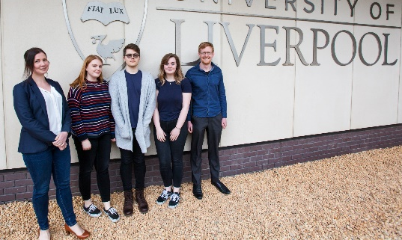
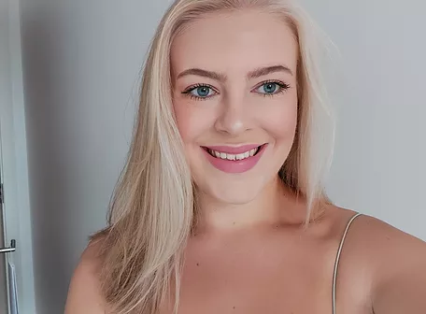
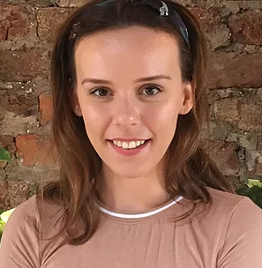
Flow Chemistry@Liverpool
Self-assembly
Organic materials & precursors
Cages
Macrocycles
Supra- molecular chemistry
Polymerisation
How you make something matters as much as the ingredients
Email: anna.slater@liverpool.ac.uk Website: agslatergroup.com Twitter: @annagslater

Slide 3
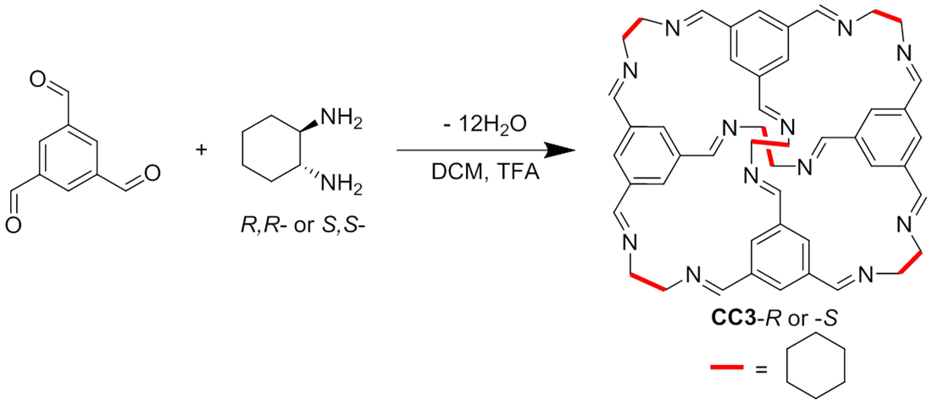
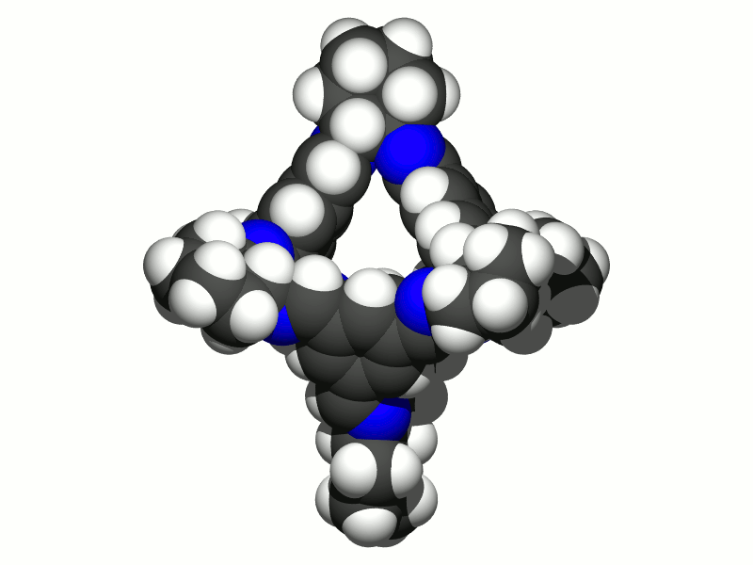
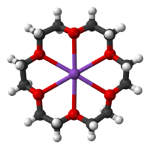
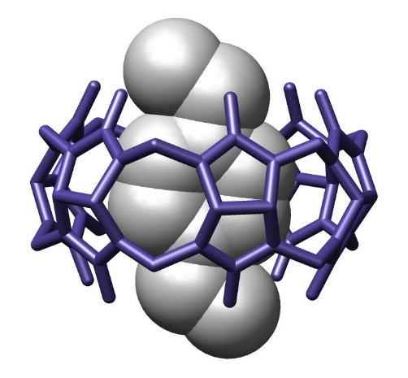
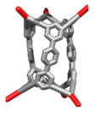
Supramolecular chemistry
Whether making a host,
assembling a host-guest complex,
or forming a supramolecular assembly…
…these process can all be profoundly changed by the reaction environment.
Concentration, mixing, temperature, rate of addition, etc changes yield, selectivity, assembly pathway, kinetic/thermodynamic product selection, thus structure, thus function.
Images: https://en.wikipedia.org/wiki/Supramolecular_chemistry and https://en.wikipedia.org/wiki/Macrocycle

Slide 4
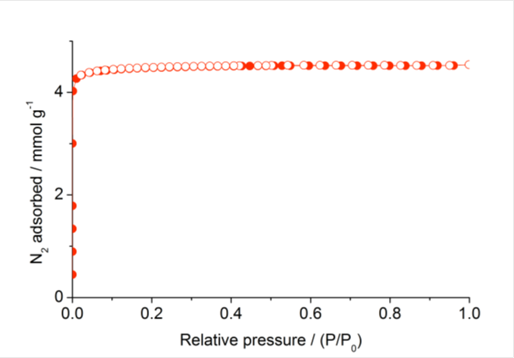
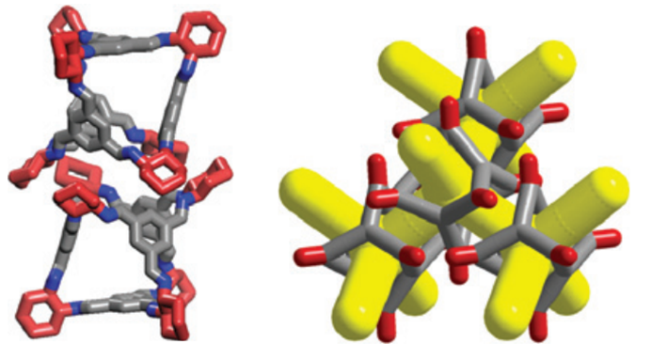
Change structure, change function
soluble
stable
easy to make
functionalizable
functional
Tozawa et. al, Nat. Mater., 2009, 8, 973

Slide 5
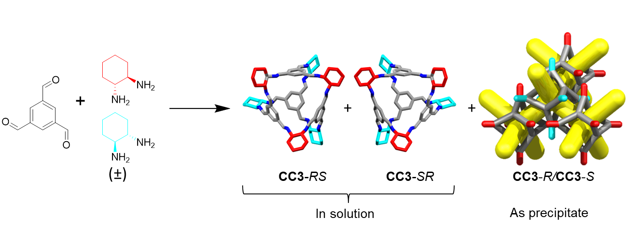
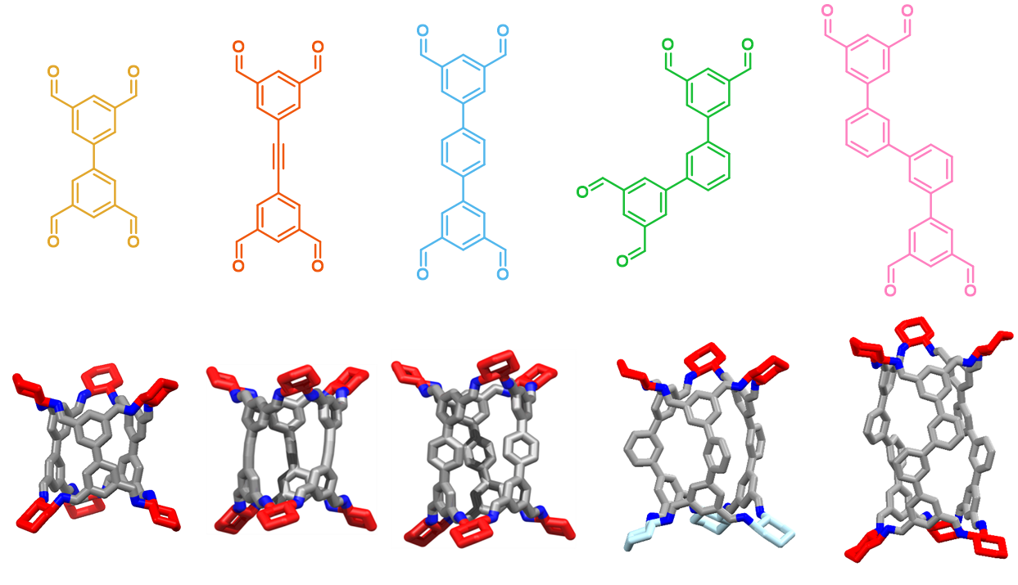
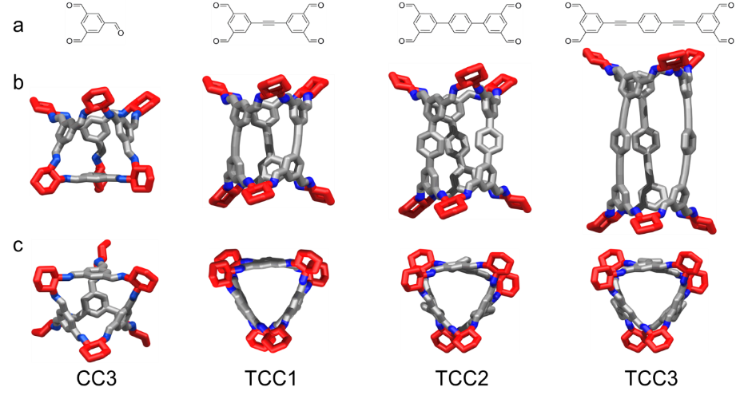
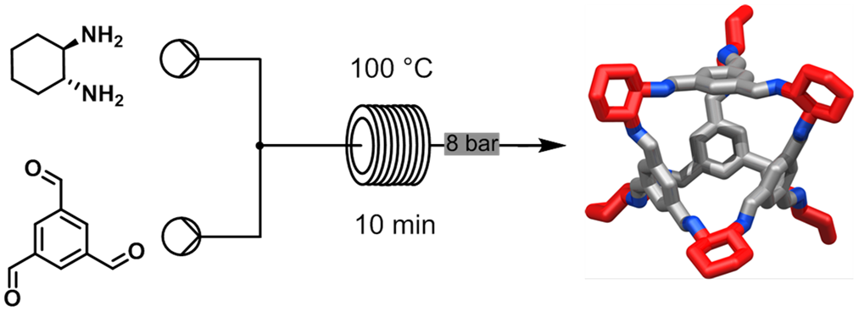
Change structure, change function
Chiral social self-sorting
MSDE, 2018, 3, 223
New pore geometries from self-sorting
ACIE, 2020, 10.1002/anie.202007571
Flow chemistry
Chem. Comm., 2015, 51, 17390
Reticular synthesis via chiral recognition Nat. Chem., 2017, 9, 17-25

Slide 6
Why does process matter?
Scale is tricky due to the use of large amounts of DCM/chloroform
Long reaction times
Complex or unwanted products possible in less well-defined systems

Slide 7
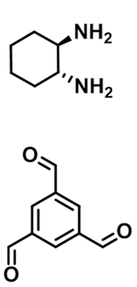
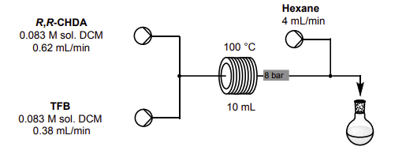
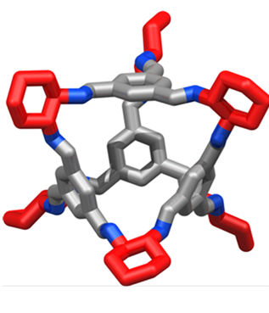
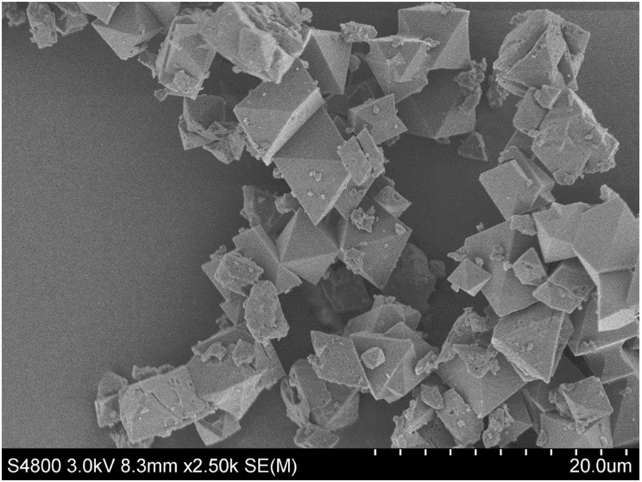
How can flow help?
95 %
Reduced the reaction time from 5 days to 10 minutes
Same purity, same yield; scalable synthesis
Can telescope with precipitation/crystallisation
Briggs, M. E.;† Slater, A. G.;† Lunt, N.; Jiang, S.; Little, M. A.; Greenaway, R. L.; Hasell, T.; Battilocchio, C.; Ley, S. V. and Cooper, A. I.; Chem. Commun., 2015, 51, 17390-17393

Slide 8
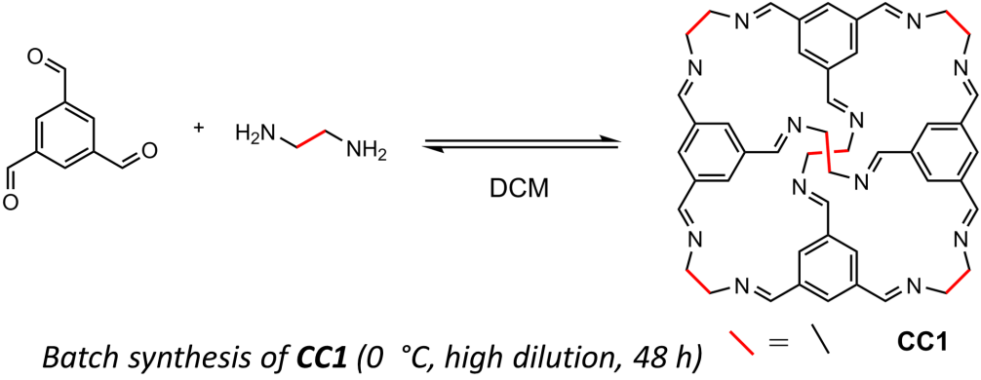
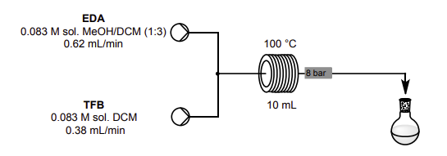
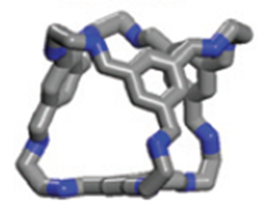
What about cages that are harder to access?
93 %
Briggs, M. E.;† Slater, A. G.;† Lunt, N.; Jiang, S.; Little, M. A.; Greenaway, R. L.; Hasell, T.; Battilocchio, C.; Ley, S. V. and Cooper, A. I.; Chem. Commun., 2015, 51, 17390-17393

Slide 9
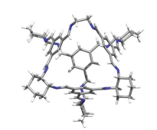
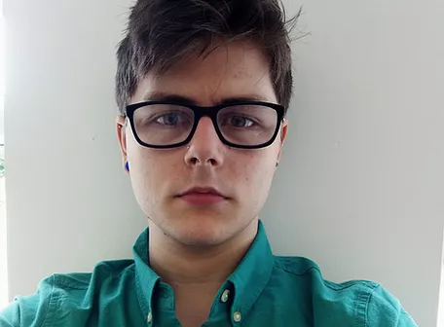
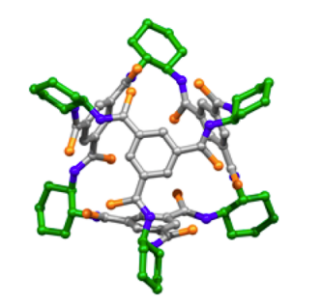
What about cages that are harder to access?
Henry Morris (PhD)
Matthew Oakes (MChem)
Caitlin Shields (MChem)
93 %
95 %
21 % after prep LC
High dilution not required?
Product selection
Continuous water removal?
Autosamplers and inline detection for cage discovery
Process intensification
Reaction investigation
Can add TFA catalyst
Alternative pathways?
Cages can be tricky! Poor solubility of precursors, multiple possible products…but a LOT of fun things to explore looking at reversible chemistry in flow.

Slide 10
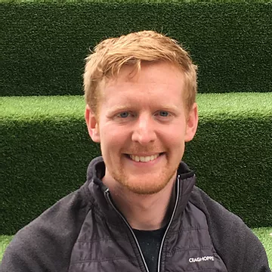
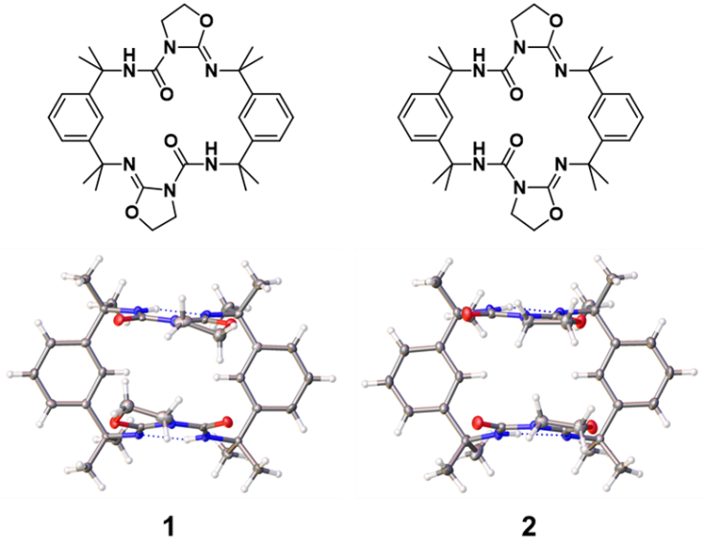
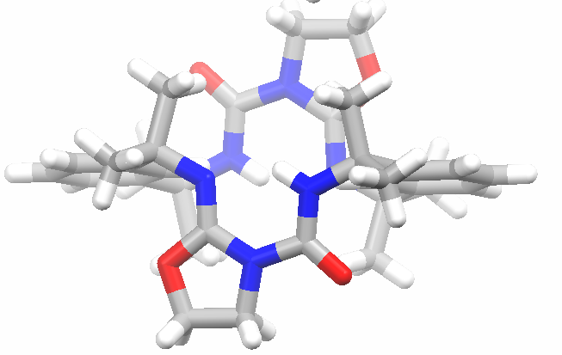
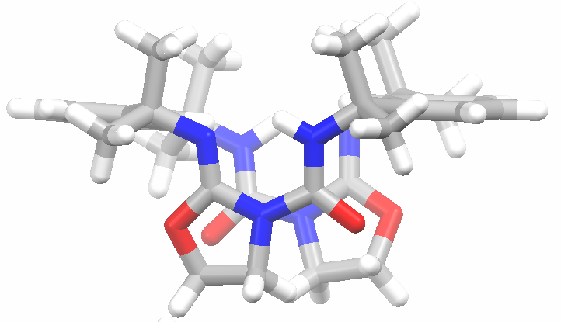
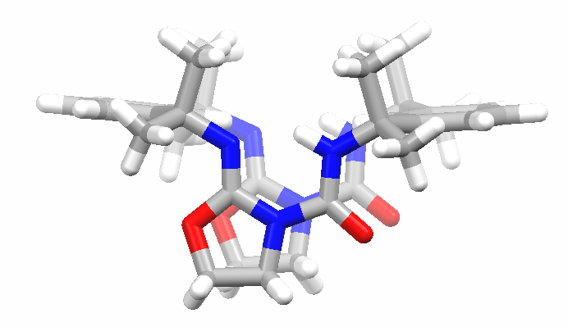
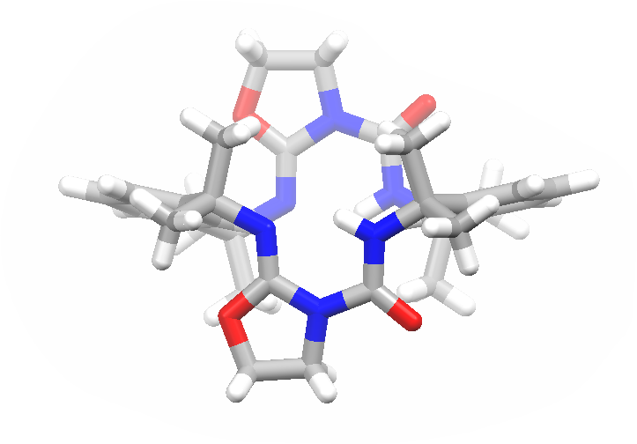
Understanding and optimising selectivity and yield in flow: a macrocyclic molecular hinge
Dr Chris Jones
syn-1
anti-1
Both isomers formed by an addition cyclisation reaction of 2-bromo- or 2-chloroethylamine with an isocyanate to form oxazolidine rings.
In batch, both isomers formed.
syn-2
anti-2
C. D. Jones, L J. K. Cook, D. Marquez-Gamez, K. V. Luzyanin, J. Steed, A. G. Slater, JACS, 2021, 143, 19, 7553-7565

Slide 11
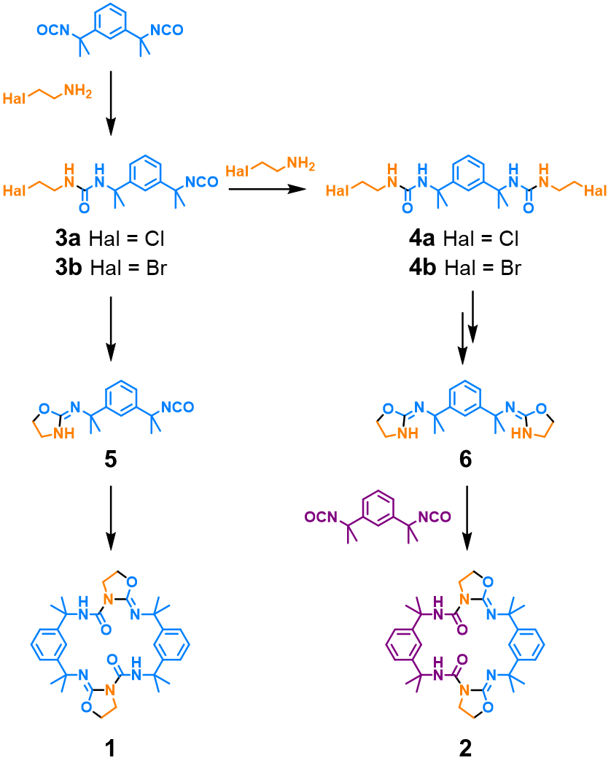
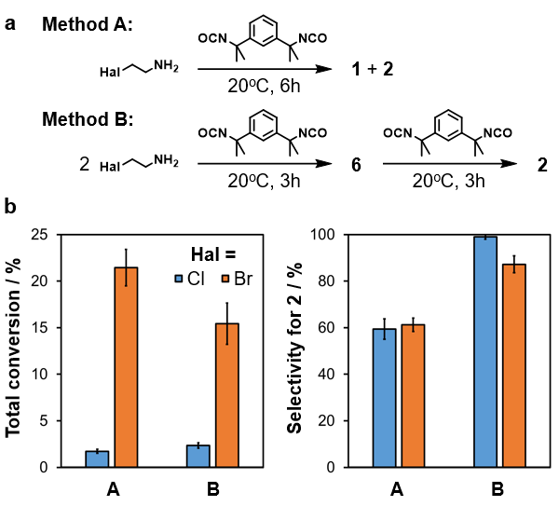
Can we optimise this synthesis?
Batch synthesis
Et₃N, CHCl₃
Higher T increases yield (76 % at 60 °C) but compromises selectivity – and T limited by solvent.
C. D. Jones, L J. K. Cook, D. Marquez-Gamez, K. V. Luzyanin, J. Steed, A. G. Slater, JACS, 2021, 143, 19, 7553-7565

Slide 12
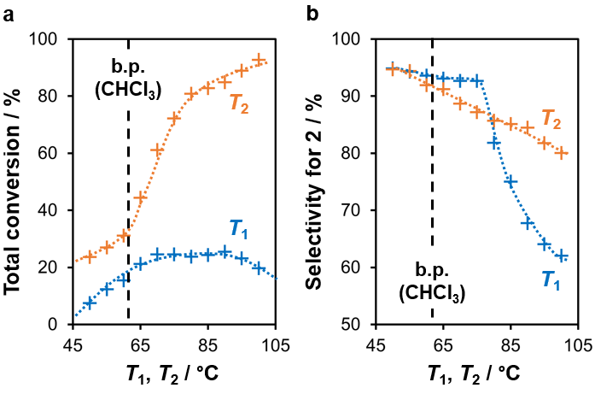
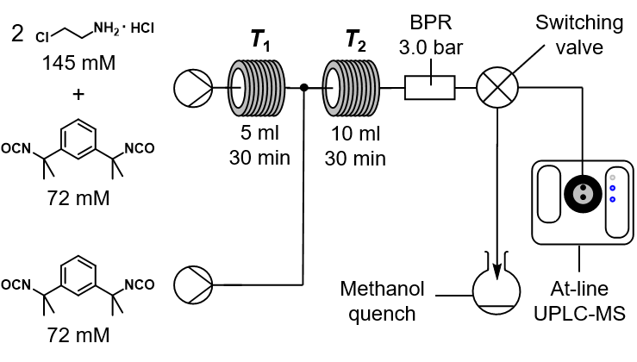
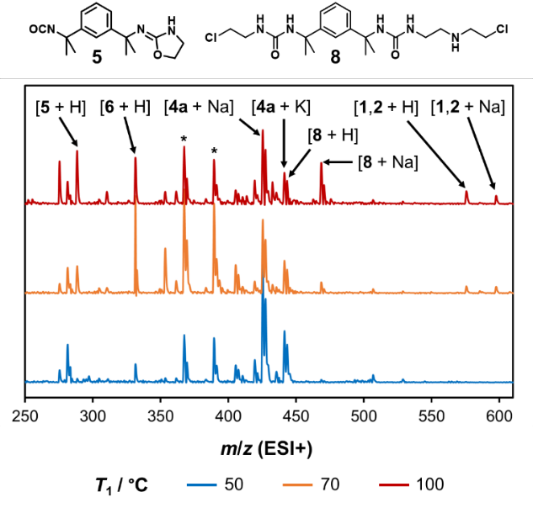
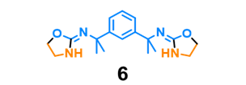
How can flow help?
When T₁ or T₂ are varied, other T is kept constant
T₁
100 °C
70 °C
T₁ 70 °C, T₂ 90 °C
Yield tripled, selectivity > 80 %
Platform for diversification
50 °C
C. D. Jones, L J. K. Cook, D. Marquez-Gamez, K. V. Luzyanin, J. Steed, A. G. Slater, JACS, 2021, 143, 19, 7553-7565

Slide 13
Conclusions
Efficiency
Scalability
of processes relevant to supramolecular chemistry…
Selectivity
Flow can help with:
Yield
Mechanistic understanding
Rapid ΔT
…and there’s lots of space to explore!
Templating
Photoswitching
Droplet synthesis
…
“Enabling technology for supramolecular chemistry”, Katie Ollerton, Rebecca Greenaway & Anna Slater, submitted for International Women in Supramolecular Chemistry special issue, Frontiers in Science, 2021

Slide 14
Acknowledgements
Slater Group
Dr Firdaus Parveen, Henry Morris, Abbie Scholes, Megan Carr, Patrycja Roszkowska, Nick Watson, Caitlin Shields, Matthew Munro, Charlotte Hutchison
Dr Chris Jones, Dr Valentina Abet, Matthew Oakes
Collaborators
Prof Andy Cooper, Dr Kim Jelfs, Prof Jon Steed, Prof Rich Bourne, Dr Michael Briggs, Dr Marc Little, Dr Konstantin Luzyanin, Dr Laurence Kershaw-Cook, Dr David Marquez-Gamez, Dr Becky Greenaway, Dr Claudio Battilocchio, Prof Steven Ley
Thank you for your attention!
Email: anna.slater@liverpool.ac.uk Website: agslatergroup.com Twitter: @annagslater

