Slide 1
Scripting chemistry workflows for automation efficiency
Nessa Carson
@SuperScienceGrl
25th February 2022

Slide 2
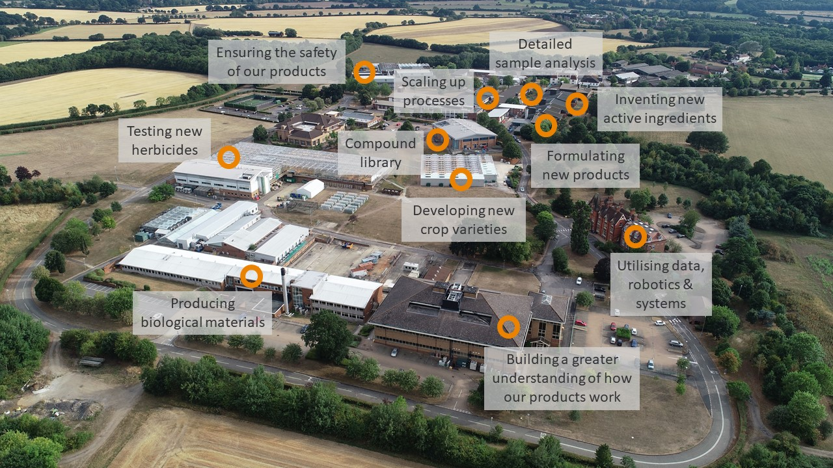
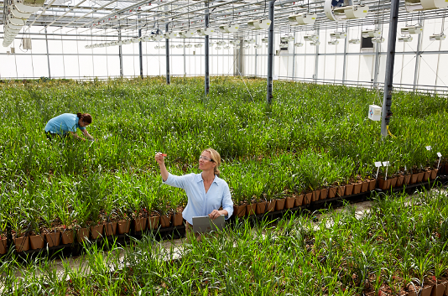
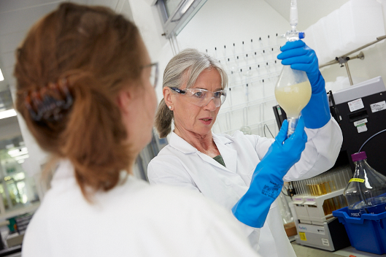
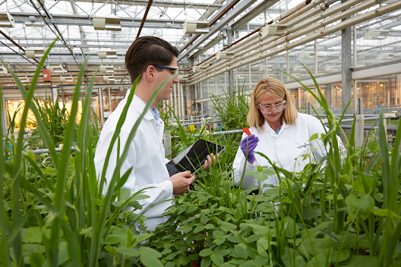
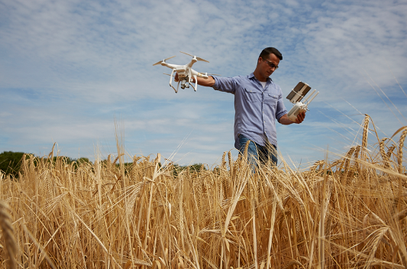
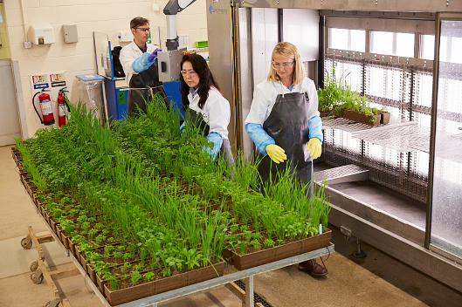
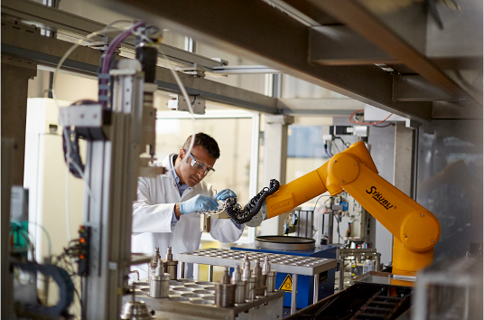
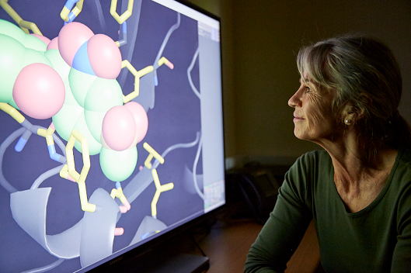
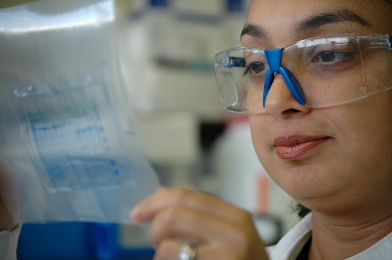
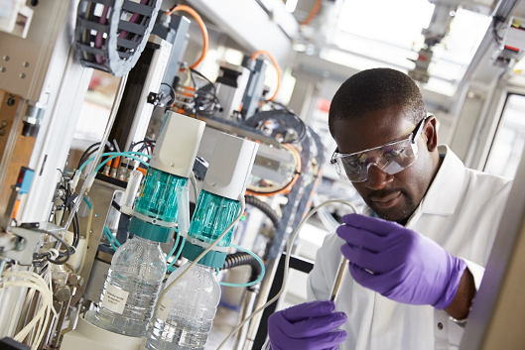
Jealott’s Hill International Research Centre
All stages of Crop Protection & Seeds Research
Syngenta’s largest & most diverse R&D site with 930 people
Over 90 years of scientific research
Over 240 active collaborations

Slide 3
The ‘S’ step of DSTA
DEA cycle
Knowing what we can make
DSTA cycle
Knowing what to make
Route and Reaction Design
Right First Time Principles
Reactivity
models
D
(Q)SPR
models
D
A
S
A
E
Analysis of Reaction Data
Execution of Chemical Synthesis
T
D^{n}
Biological profile
Design in Support Platforms
Right Second Time Principles
Reaction Optimisation
Reaction Robustness

Slide 4
One Factor at a Time
Entry
Ligand
Base
Solvent
Yield
1
Amphos
DIPEA
acetonitrile
34%
2
CataCXium
A
DIPEA
acetonitrile
14%
3
DCEPhos
DIPEA
acetonitrile
61%
4
dcpe
DIPEA
acetonitrile
0%
5
dcpp
DIPEA
acetonitrile
0%
6
DPEPhos
DIPEA
acetonitrile
52%
7
dppe
DIPEA
acetonitrile
0%
8
dppf
DIPEA
acetonitrile
58%
9
dppp
DIPEA
acetonitrile
16%
10
PMe
t
-
Bu
2
DIPEA
acetonitrile
0%
11
P
o
-
Tol
3
DIPEA
acetonitrile
0%
12
P
t
-
Bu
3
DIPEA
acetonitrile
25%
13
PCy
3
DIPEA
acetonitrile
0%
14
PPh
3
DIPEA
acetonitrile
4%
15
QPhos
DIPEA
acetonitrile
4%
16
Xantphos
DIPEA
acetonitrile
81%
Nature Catal. 2019, 2, 2–4

Slide 5
One Factor at a Time leads chemists astray
A
+
B
C
Entry
Ligand
Base
Solvent
Yield
21 of 96 possible combinations run
Best ligand – Xantphos?
Best base – DIPEA?
Best solvent – acetonitrile?
“Classical screening gives a local maximum – not a fully optimized system”
16
Xantphos
DIPEA
acetonitrile
81%
17
Xantphos
DIPEA
toluene
67%
18
Xantphos
K
2
CO
3
acetonitrile
70%
19
Xantphos
K
2
CO
3
toluene
20%
20
Xantphos
KOAc
acetonitrile
10%
21
Xantphos
KOAc
toluene
17%
Nature Catal. 2019, 2, 2–4

Slide 6
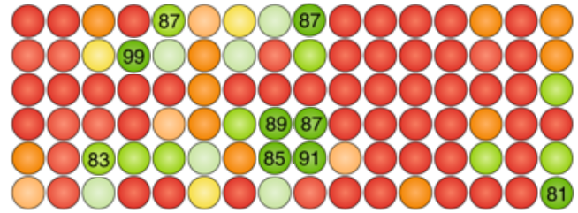
Full-factorial design
CataCXium A
Amphos
DCEPhos
dcpe
dcpp
DPEPhos
dppe
dppf
dppp
PMet-Bu₂
Po-Tol₃
Pt-Bu₃
PCy₃
PPh₃
QPhos
Xantphos
KOAc
toluene
K₂CO₃
DIPEA
KOAc
acetonitrile
K₂CO₃
DIPEA
Earlier conditions still look good – but 8 better sets exist
All of our previous guesses were incorrect!
Nature Catal. 2019, 2, 2–4

Slide 7
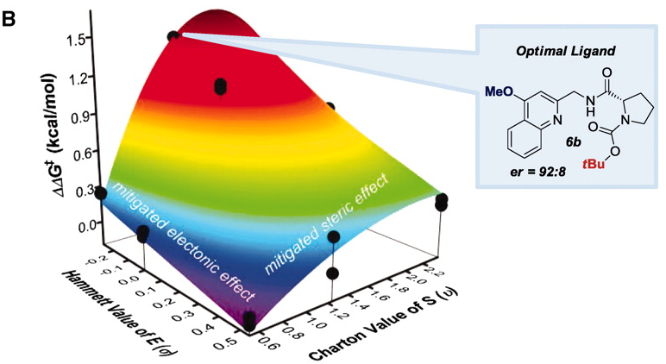
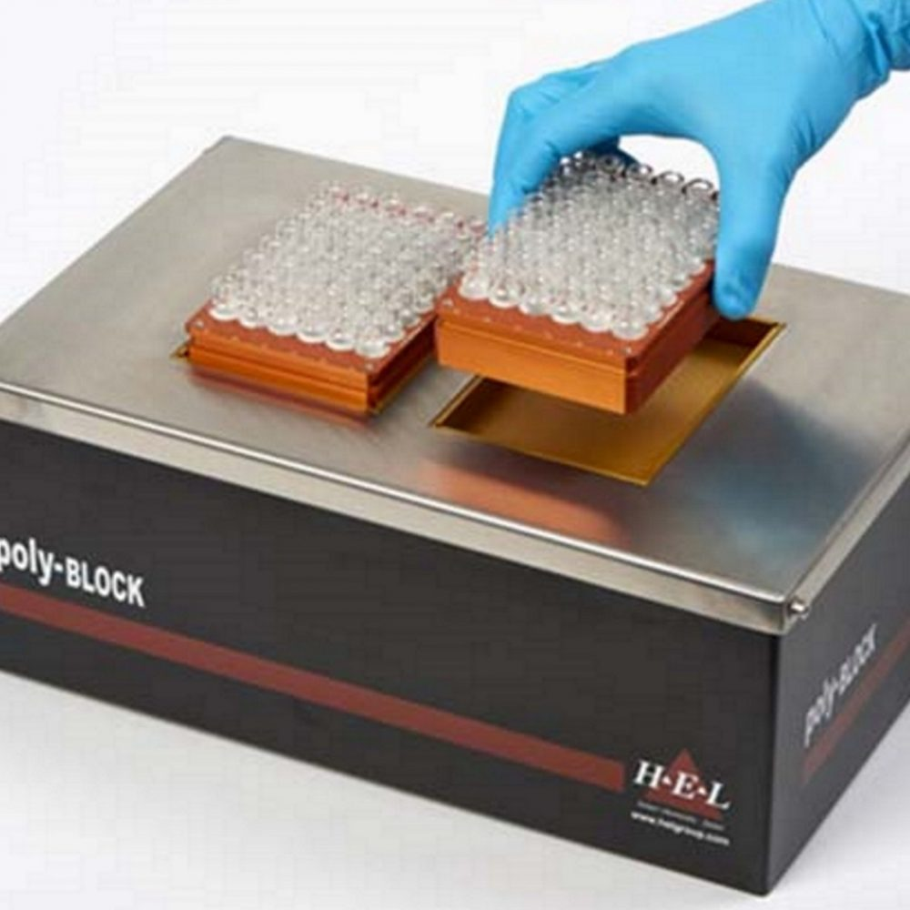
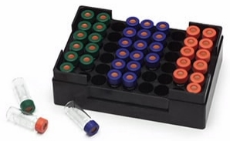
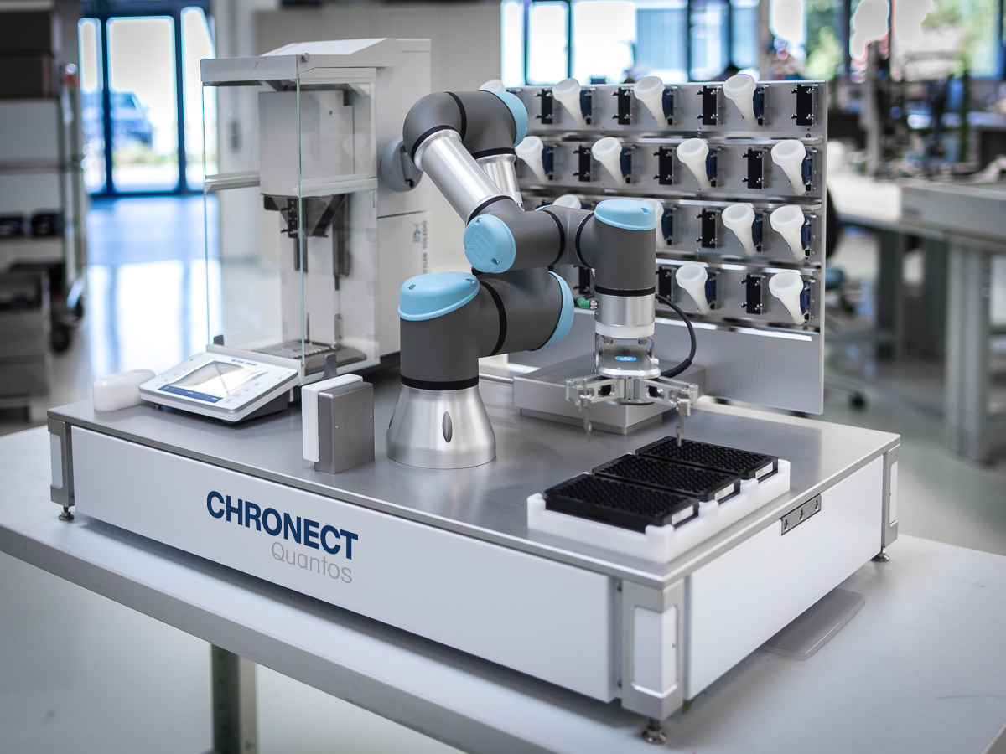
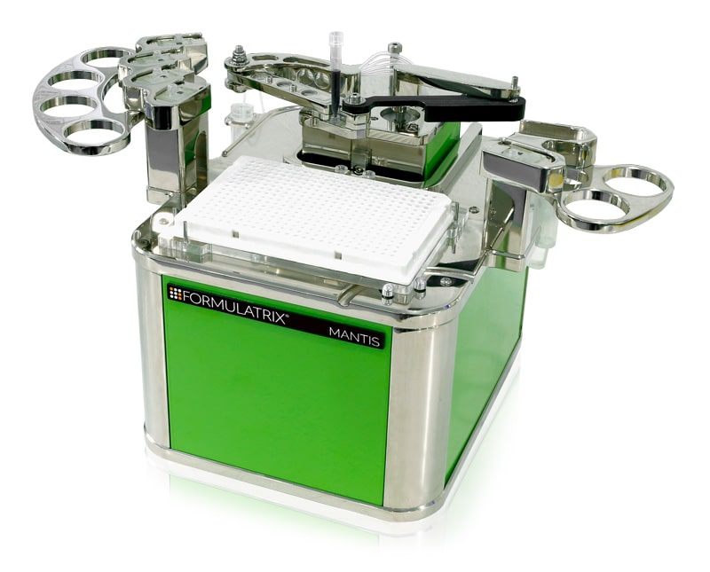
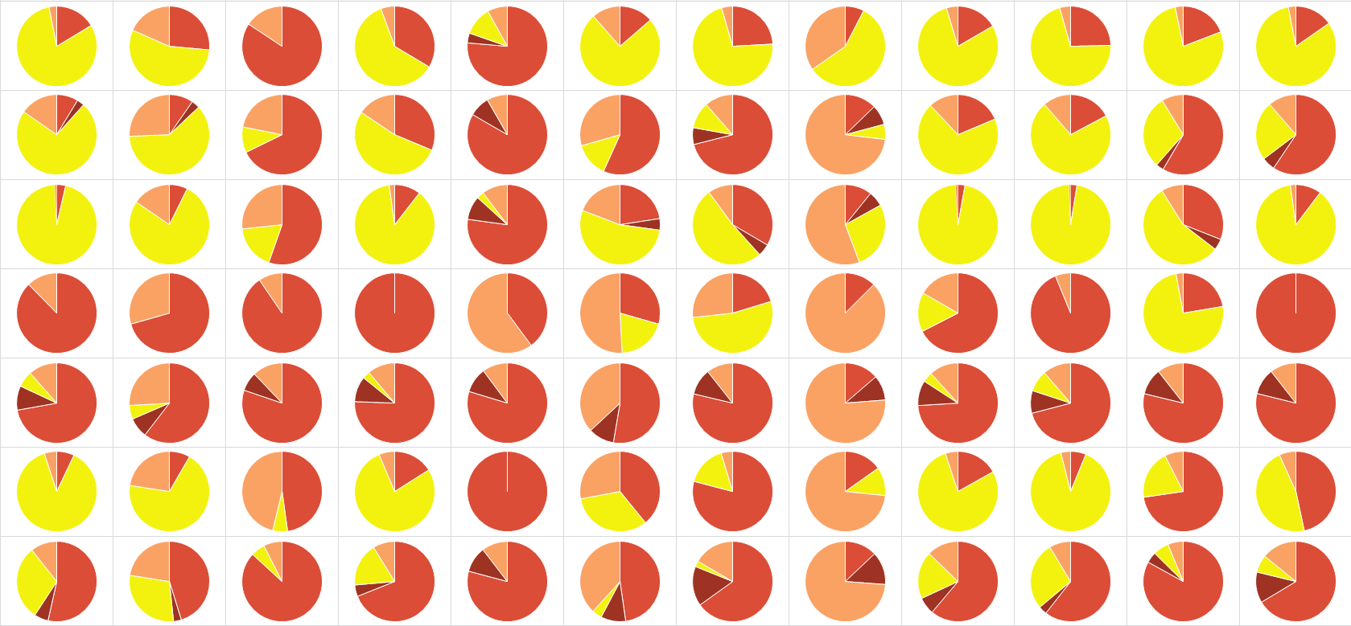
Anatomy of a HTE lab
solid dispensing
heat, cool, agitate
reporting and closing the loop
add liquids
quantitative analysis
Perspective on the enabling impacts of HTE: Chem. Eur. J., 2020, 26, 3194–3196
Ligand space surface plot: Science, 2011, 333, 1875–1878, © AAAS; Mantis robot: Formulatrix; Chronect Quantos robot: Axel Semrau; PolyBLOCK Plate: HEL

Slide 8
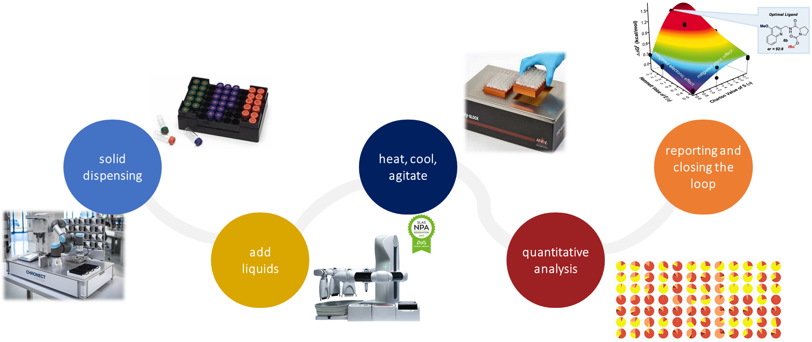
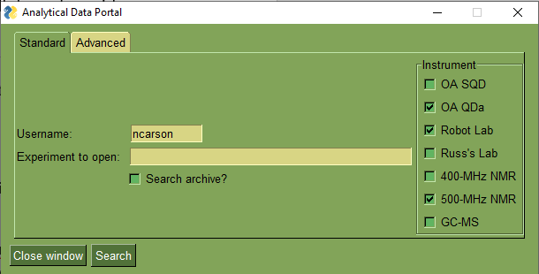
Data flow enables enabling technology
HTE runs on data science: data management is critical at all steps
Data must be FAIR at all points
Data collection must be very fast (automated), and user-friendly
Data chemists want:
Incorporation of FAIR metadata
Good data standards
Synthetic chemists want:
Decrease in admin
Recommended Python packages: PySimpleGUI, pyinstaller, Dash/plotly, OpenPyXL, pandas

Slide 9
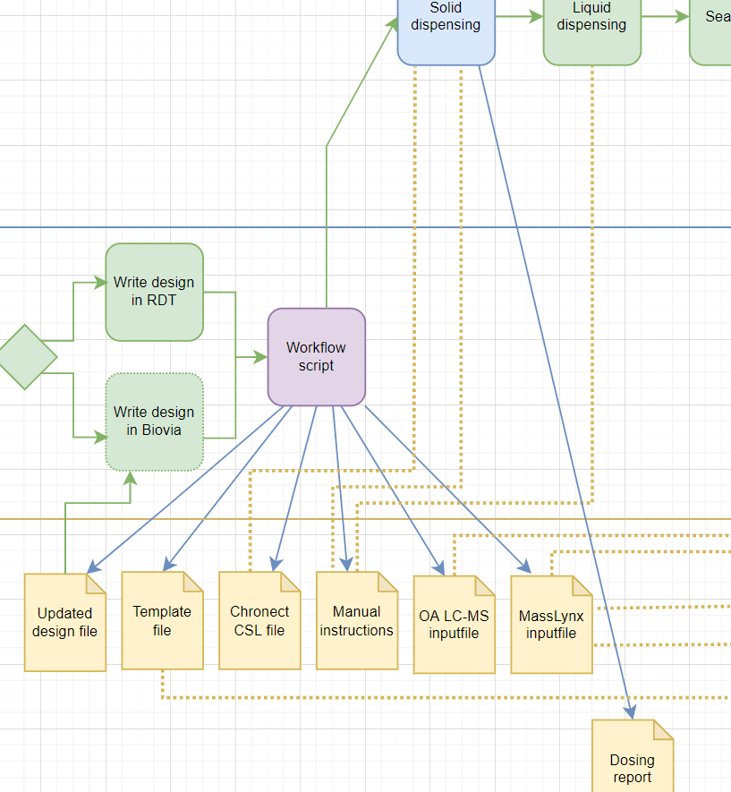
Mapping a workflow
Include every elementary step
Minimize manual script initiation
Automate all possible data manipulation
Anticipate deviations from “standard” behaviour
Diagram created using diagrams.net

Slide 10
Before workflow automation
Writing files
Automation
Manual work
Original, manual-heavy workflow
eLN
Solid dispenser
instructions
Result table
Sequence
Computer work
LC-MS analysis
Manual processing
Copy files
Process to single report
Amend result table
Solid dosing
Liquid dosing
Seal plate
Lab/Robots
Take off reaction & sample
Run reaction

Slide 11
Automation chemists’ admin is now reduced
Writing files
Automation
Manual work
New, streamlined workflow
eLN
Run workflow
LC-MS analysis
Batch process & report
Computer work
Run tidy
Solid dosing
Liquid dosing
Seal plate
Lab/Robots
Take off reaction & sample
Run reaction

Slide 12
Some hard-won advice…
data management
The road less travelled
Custom, niche middleware development
A go-between is required: lots of medium/shallow domain knowledge
Variable time commitment
Most chemists are not (currently) trained in data science
data freedom
The future is…
Smoothing the path to change
Automatic data collection
Find a broad network, fast
Be clear on your applicability domain
Make things easy for your users
Repeatedly assess and demonstrate value
Be liberal with including people
Choose your language to smooth change
communication
Image by Badboo, dreamstime.com

Slide 13
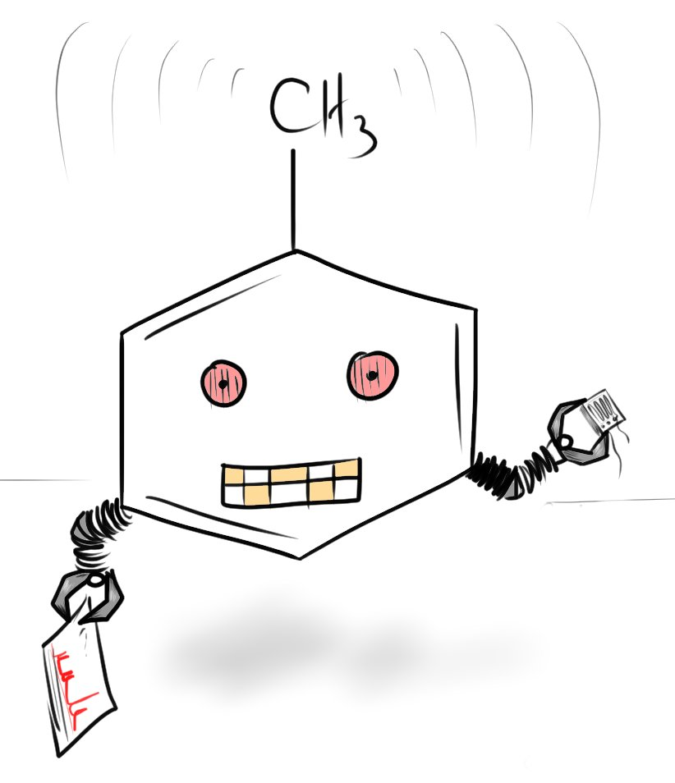
Nessa Carson
@SuperScienceGrl
supersciencegrl.co.uk
Acknowledgements
Automation team
Claudio Battilocchio
Guillaume Berthon
David Burns
Paul Cox
Simon Jaeckh
Andrew Ledgard
Kenny Ling
Chris Martin
Simon Mutton
Tomas Smejkal
Digital colleagues
David Gravestock
Vadim Kaplanov
Daniel Kloer
James Peace
Image by ChemScrapes
13
Classification: PUBLIC AAA

